Slide 1
(Transcriptomic) Heterogeneity
Update 07/29/22
Keon Arbabi
07/29/22
1

Slide 2
Question: is neuronal homogeneity reflected in the transcriptome?
Measure: variability in gene expression levels
Keon Arbabi
07/29/22
2

Slide 3
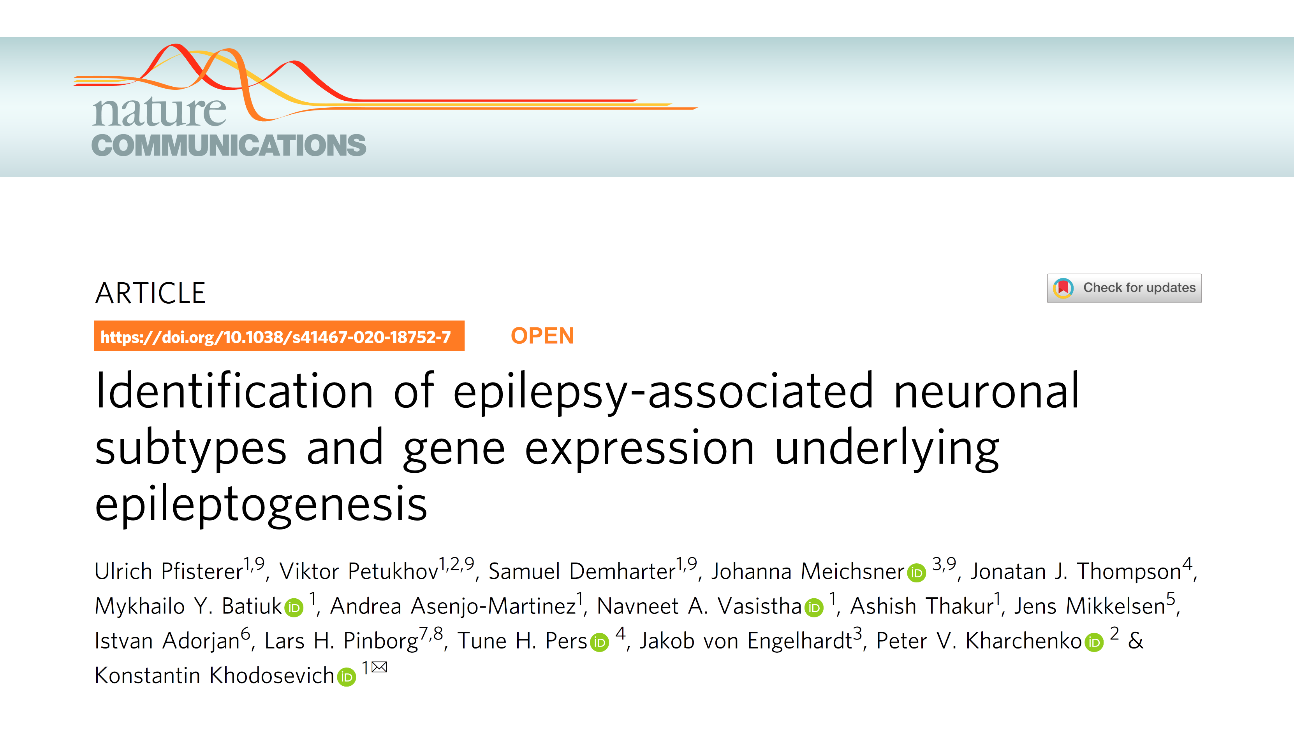
Keon Arbabi
07/29/22
3

Slide 4
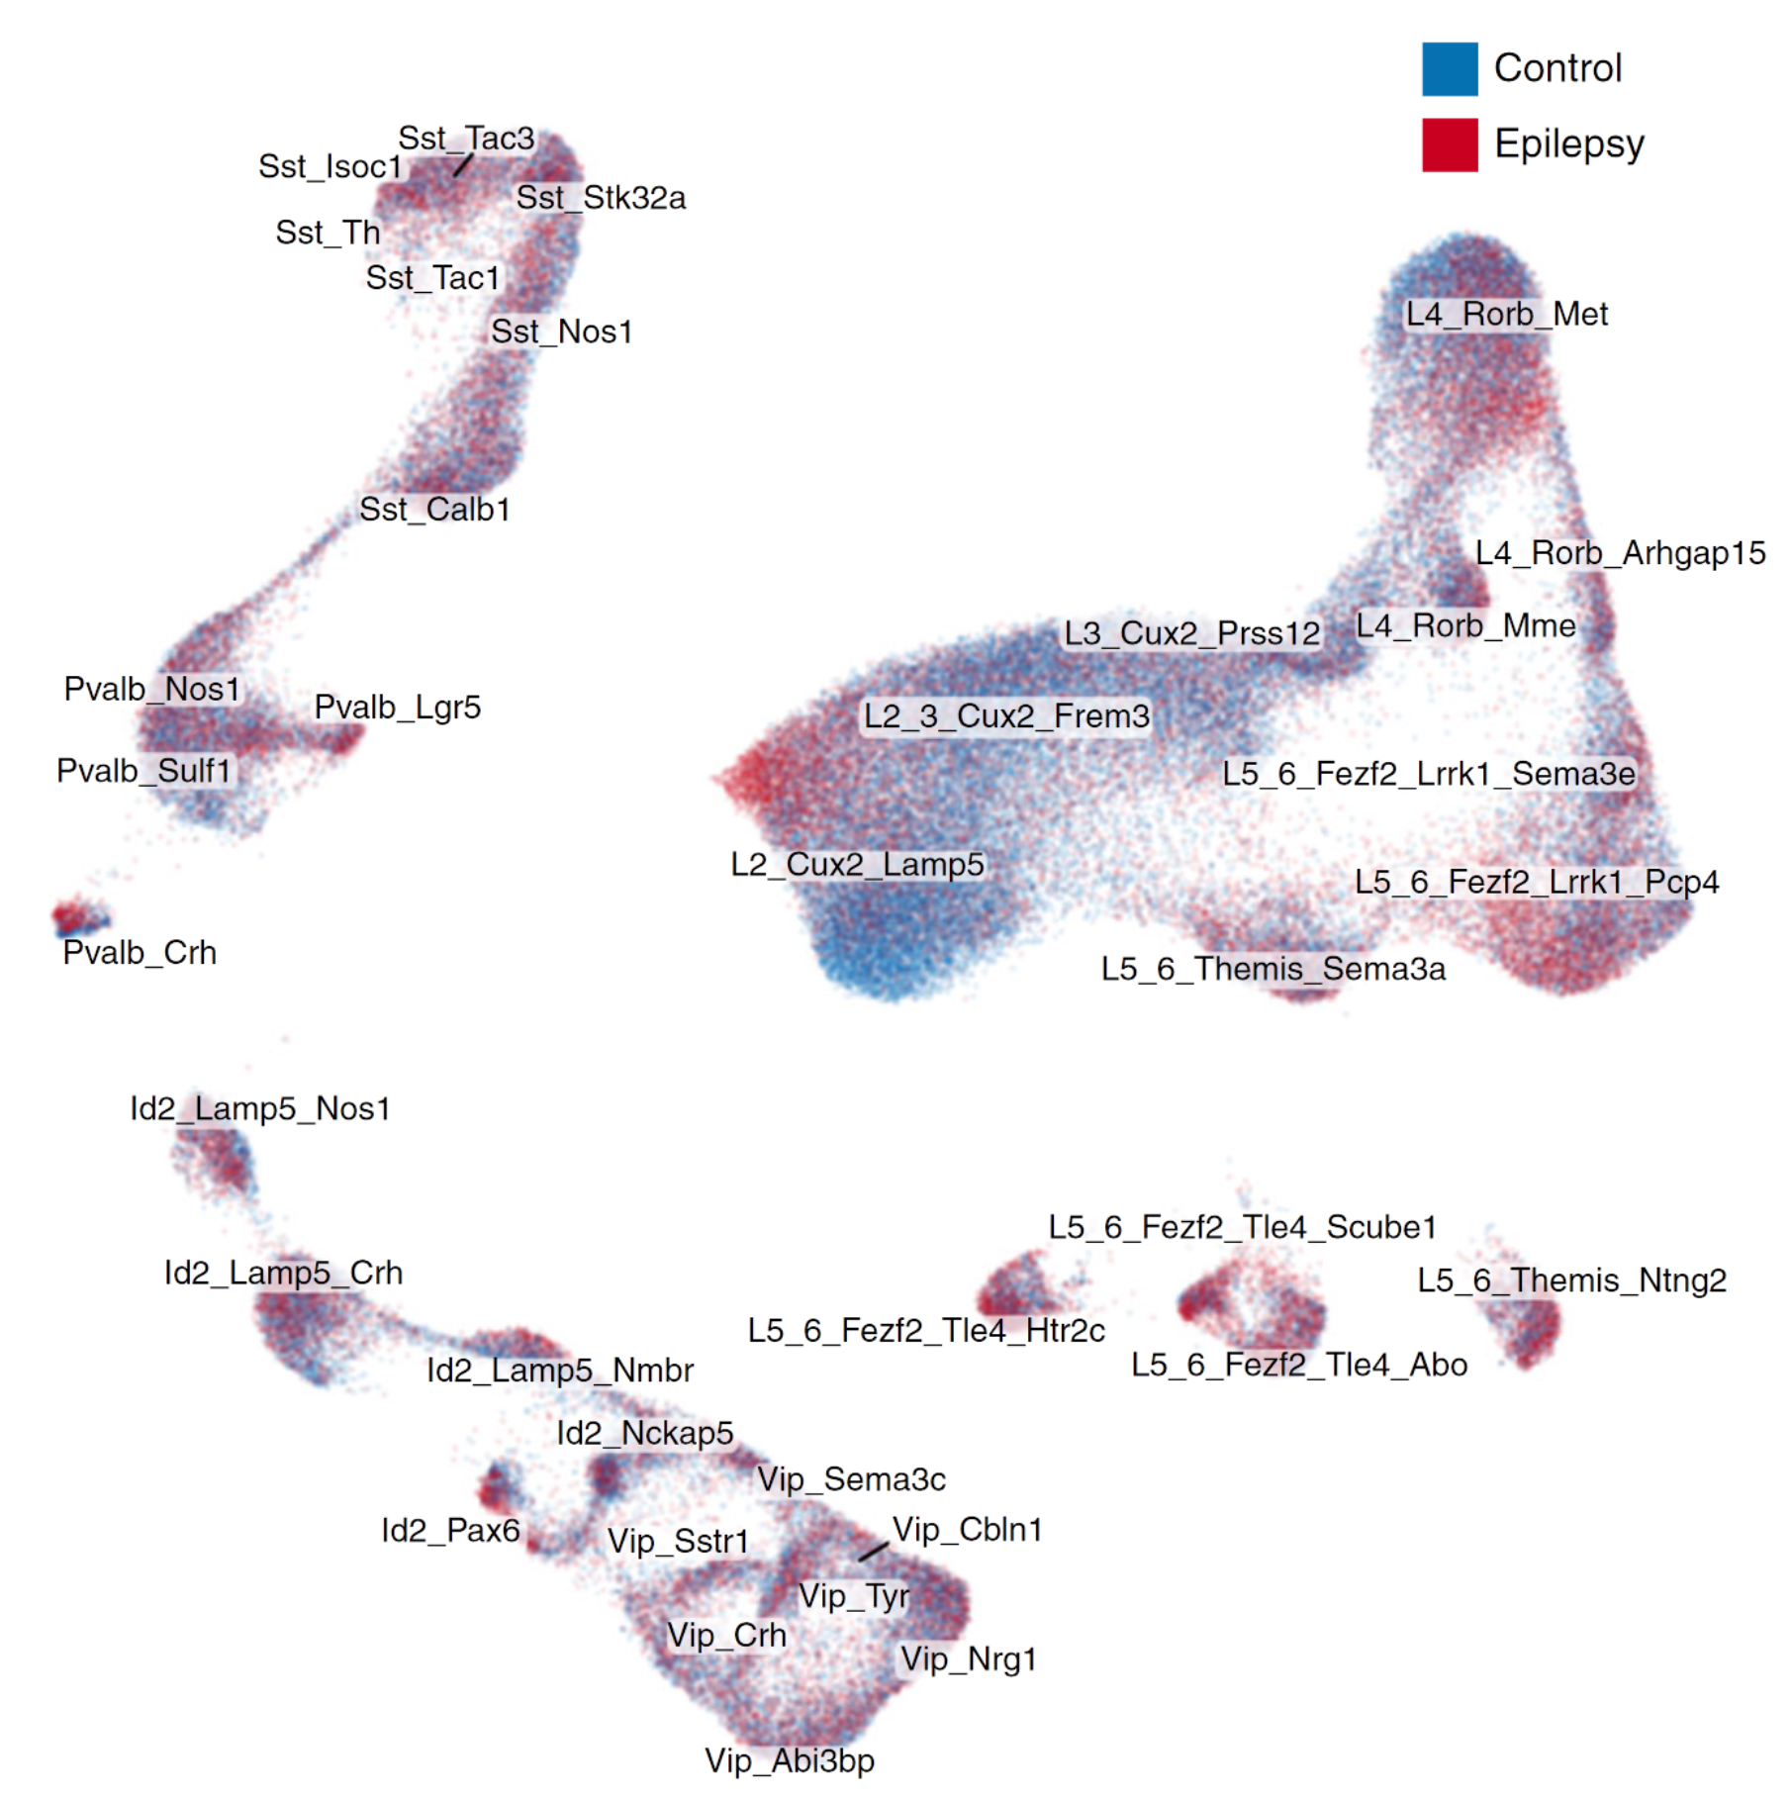
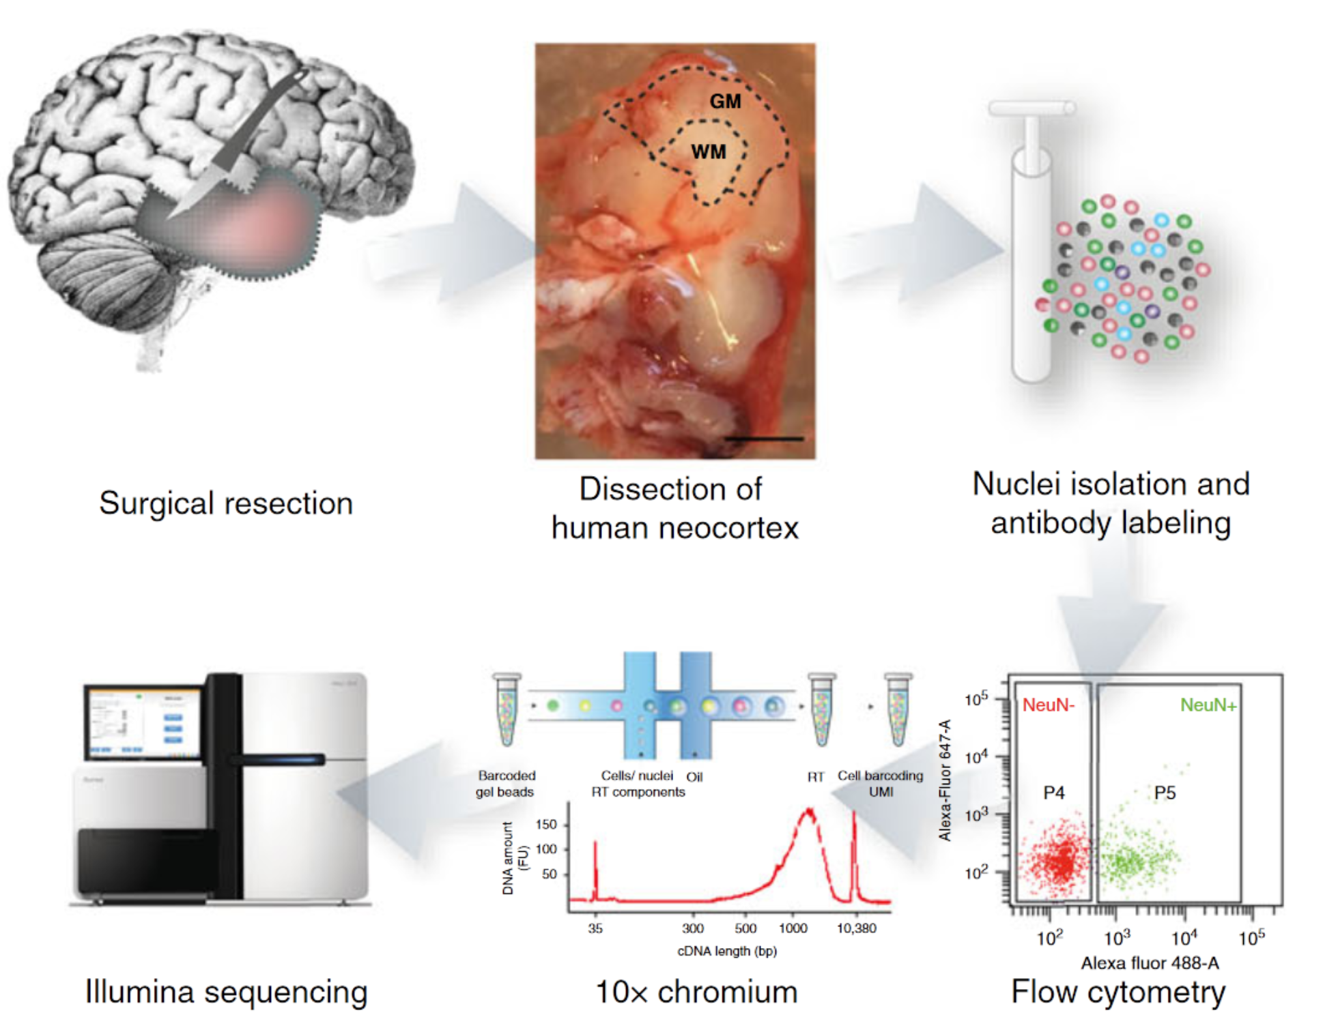
Keon Arbabi
07/29/22
4

Slide 5
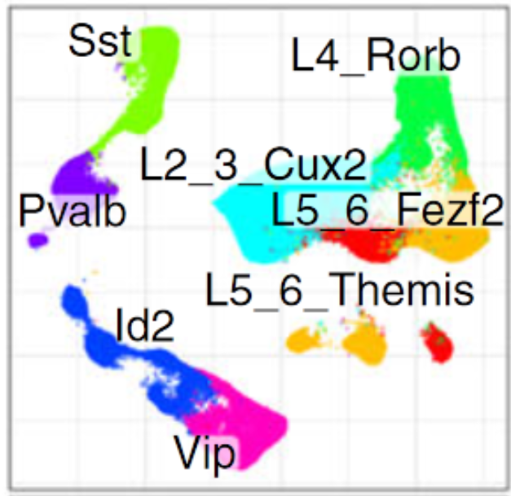
 | Cell 1 | Cell 2 | Cell 3 | Cell 4 | Cell 5
Gene 1 | 699 | 0 | 765 | 755 | 0
Gene 2 | 345 | 0 | 301 | 0 | 398
Gene 3 | 60 | 0 | 0 | 45 | 0
Subject 1 | Epilepsy
Subject 2 | Epilepsy
Subject 3 | Control
Subject 4 | Control
Keon Arbabi
07/29/22
5

Slide 6
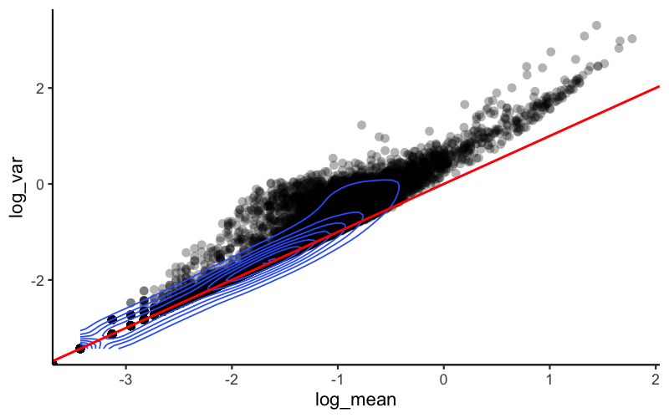
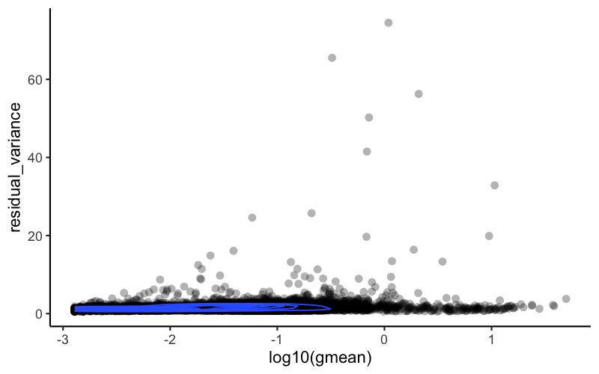
Keon Arbabi
07/29/22
6

Slide 7
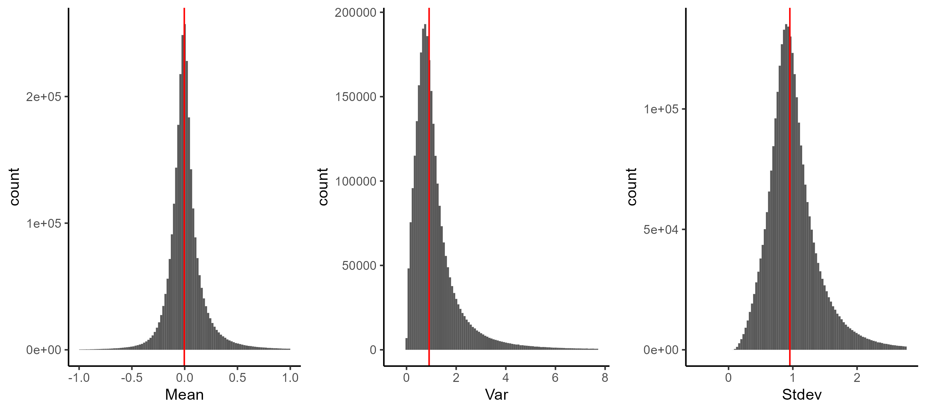
Keon Arbabi
07/29/22
7

Slide 8
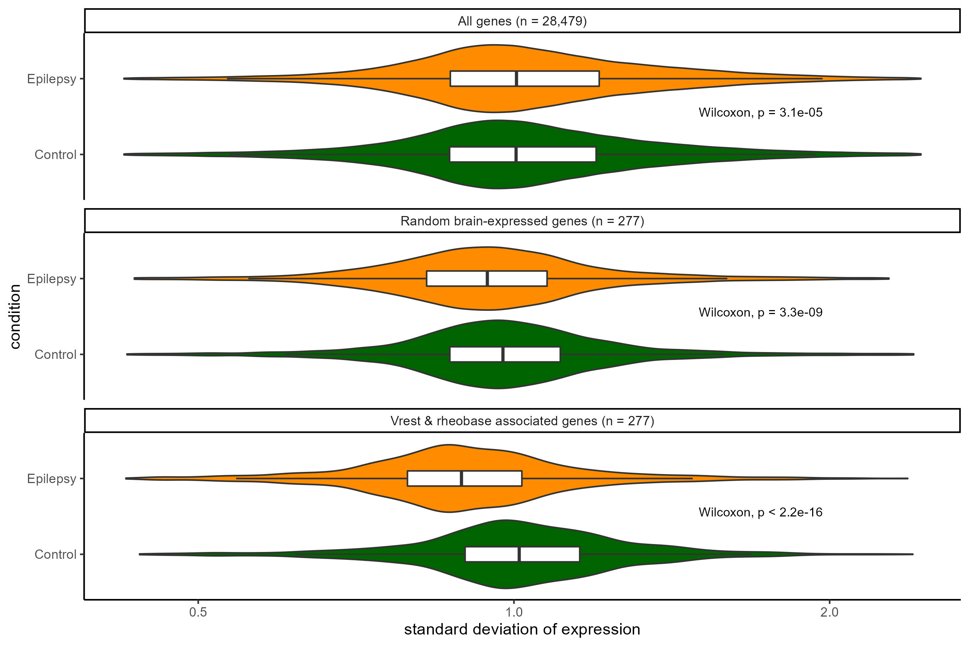
Keon Arbabi
07/29/22
8

Slide 9
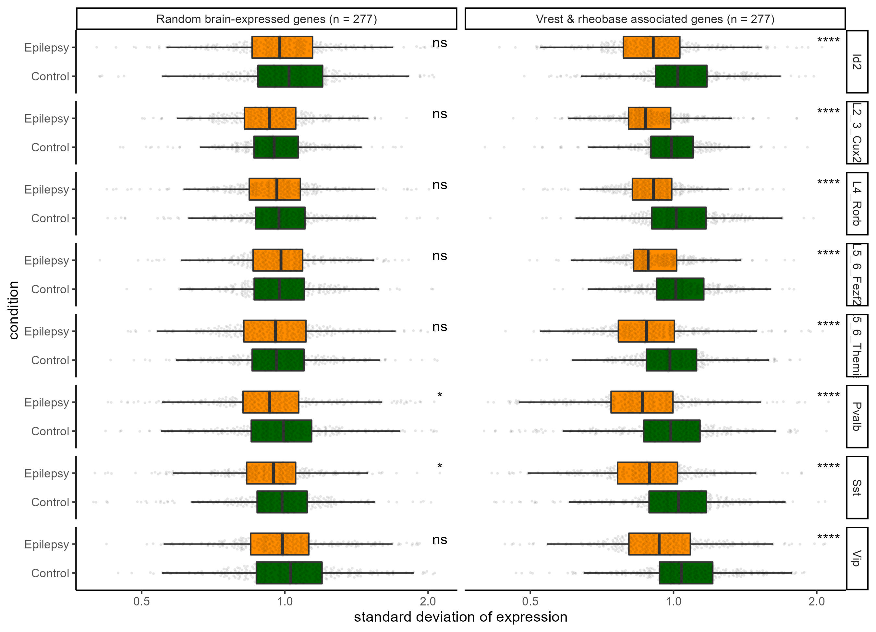
Keon Arbabi
07/29/22
9

Slide 10
Keon Arbabi
07/29/22
10

Slide 11
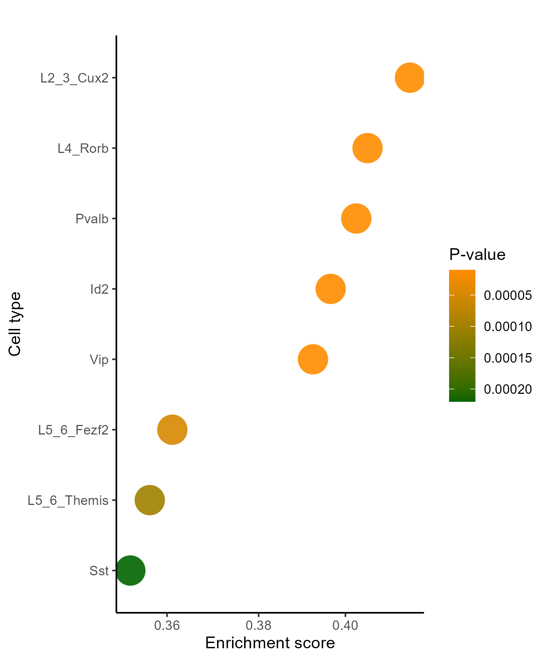
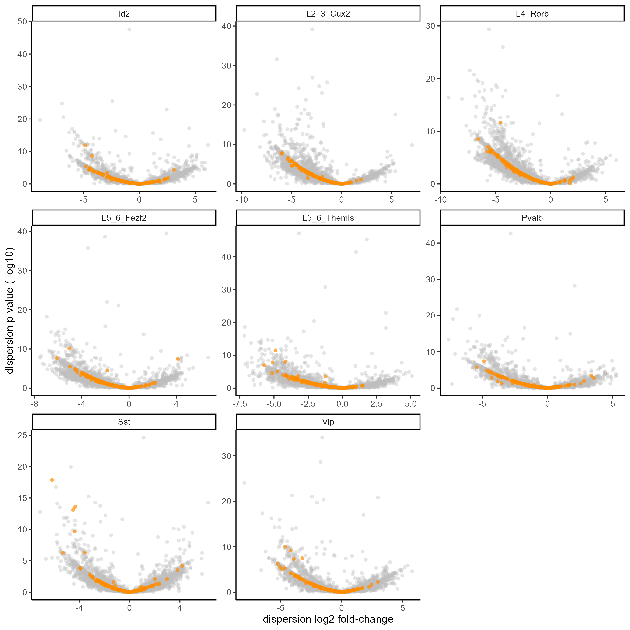
Keon Arbabi
07/29/22
11

Slide 12
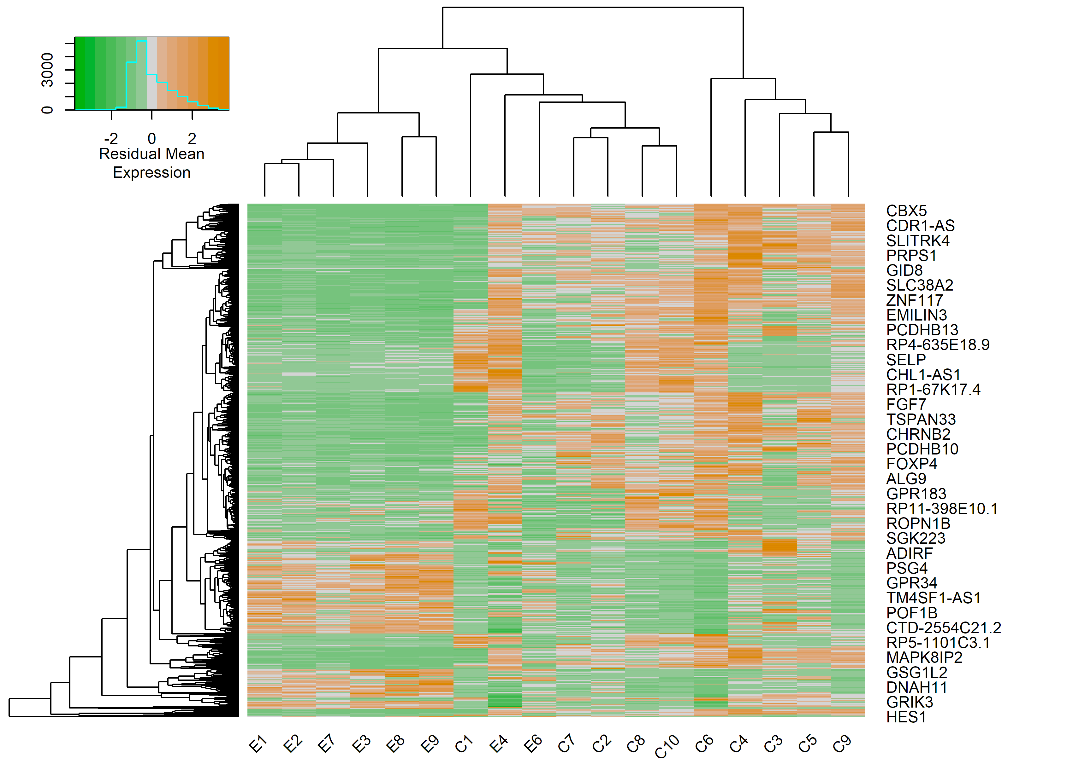
Keon Arbabi
07/29/22
12

Slide 13
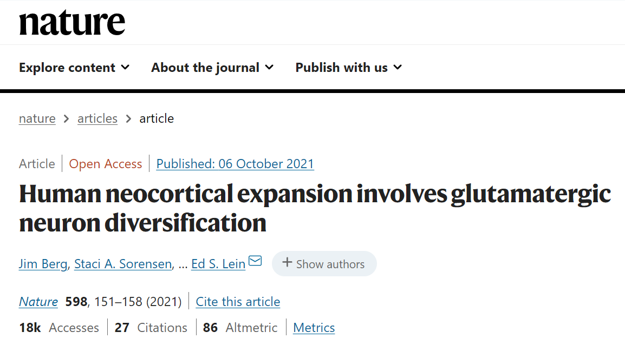
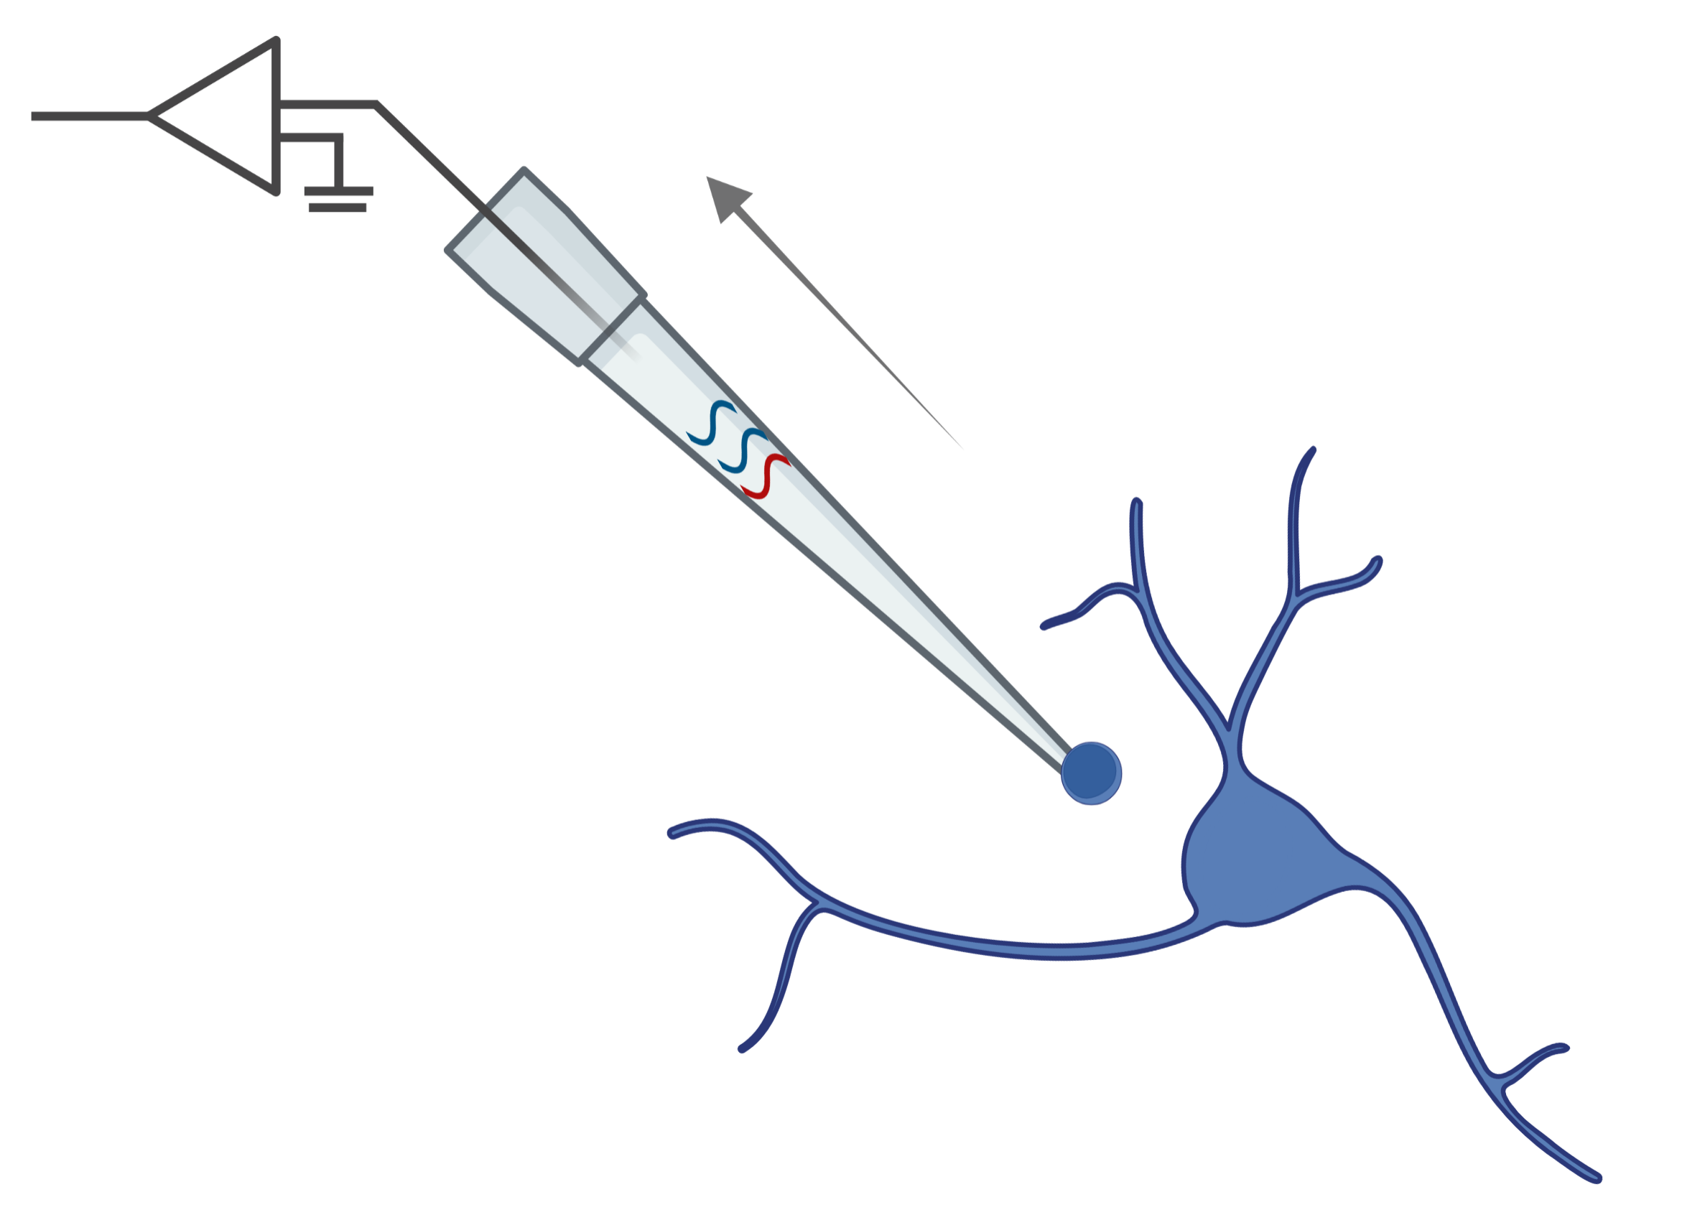
Keon Arbabi
07/29/22
13

Slide 14
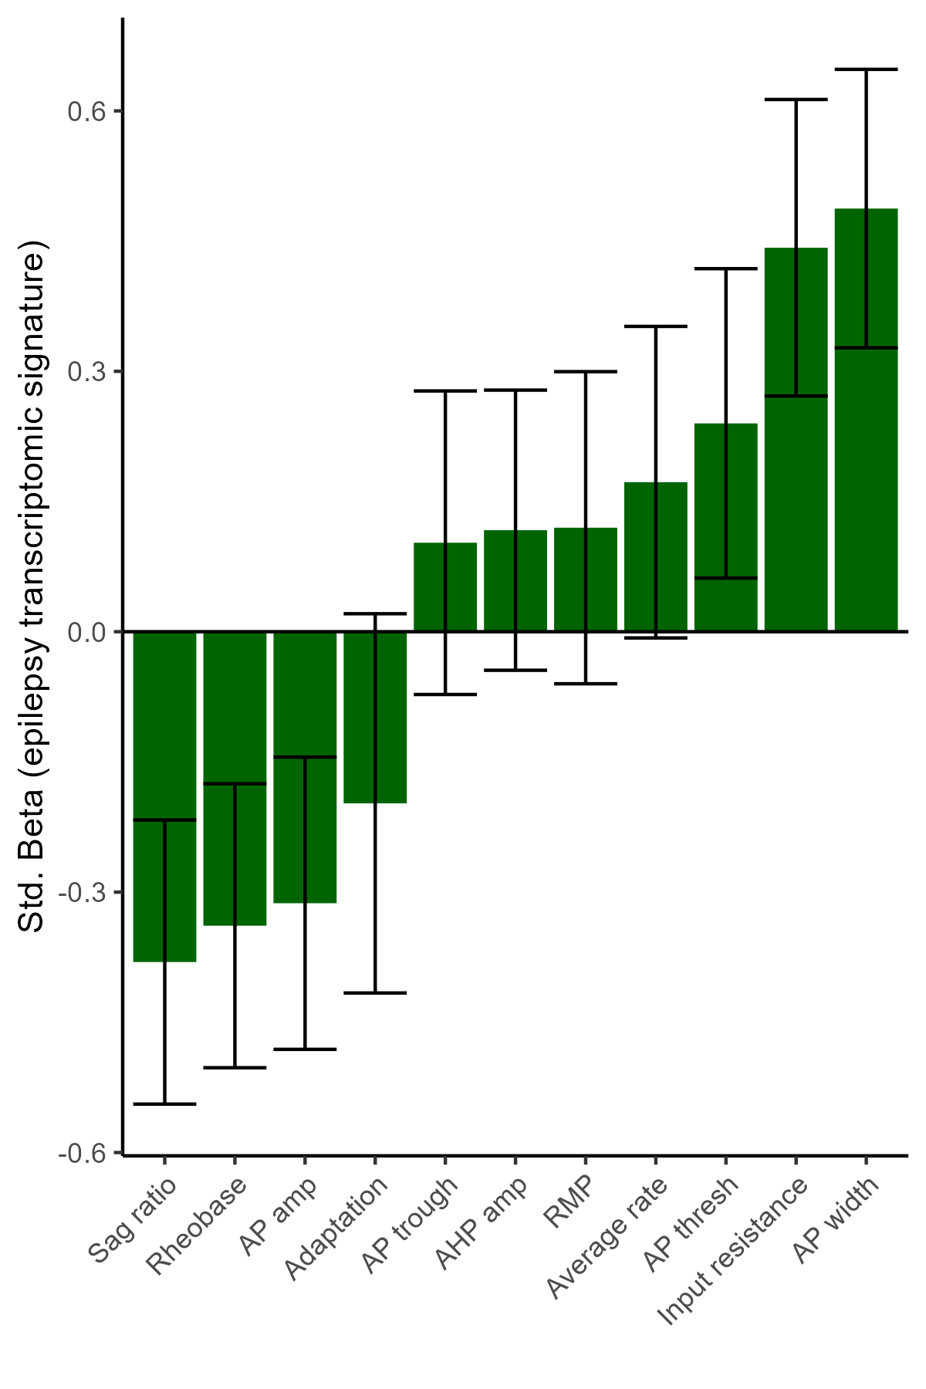
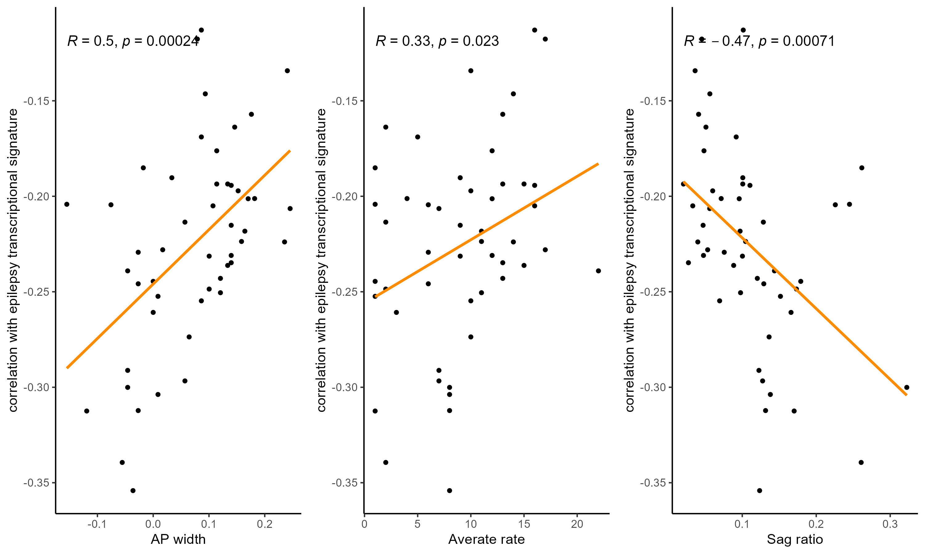
Keon Arbabi
07/29/22
14

Slide 15
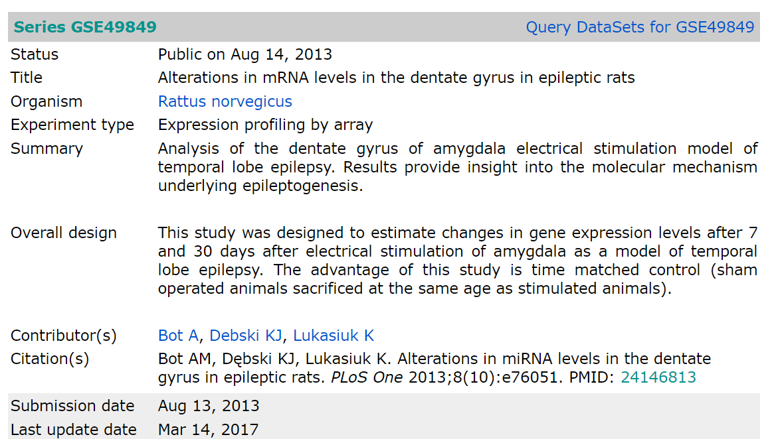
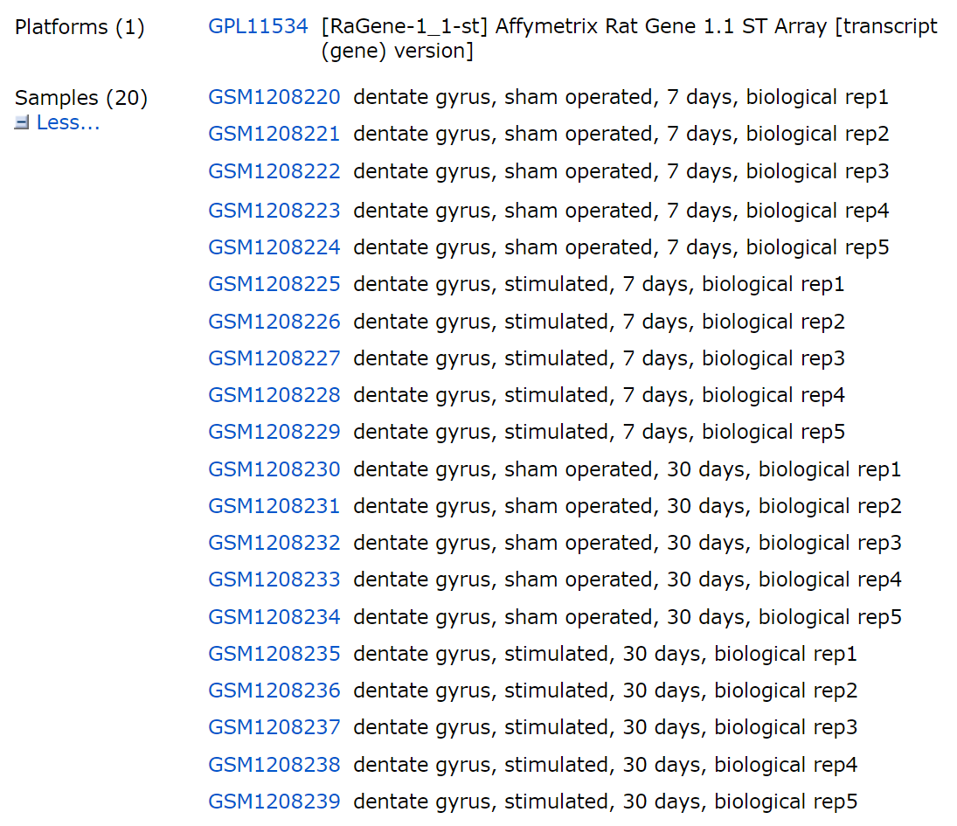
Keon Arbabi
07/29/22
15

Slide 16
Fin
Keon Arbabi
07/29/22
16

Slide 17
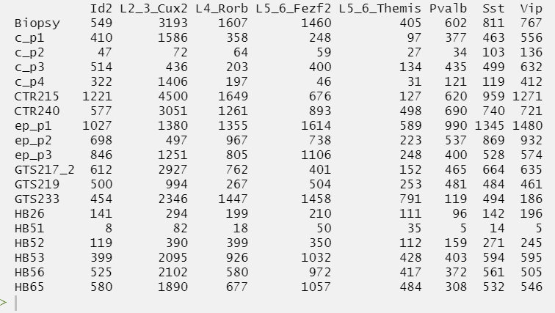
Keon Arbabi
07/29/22
17

Slide 18
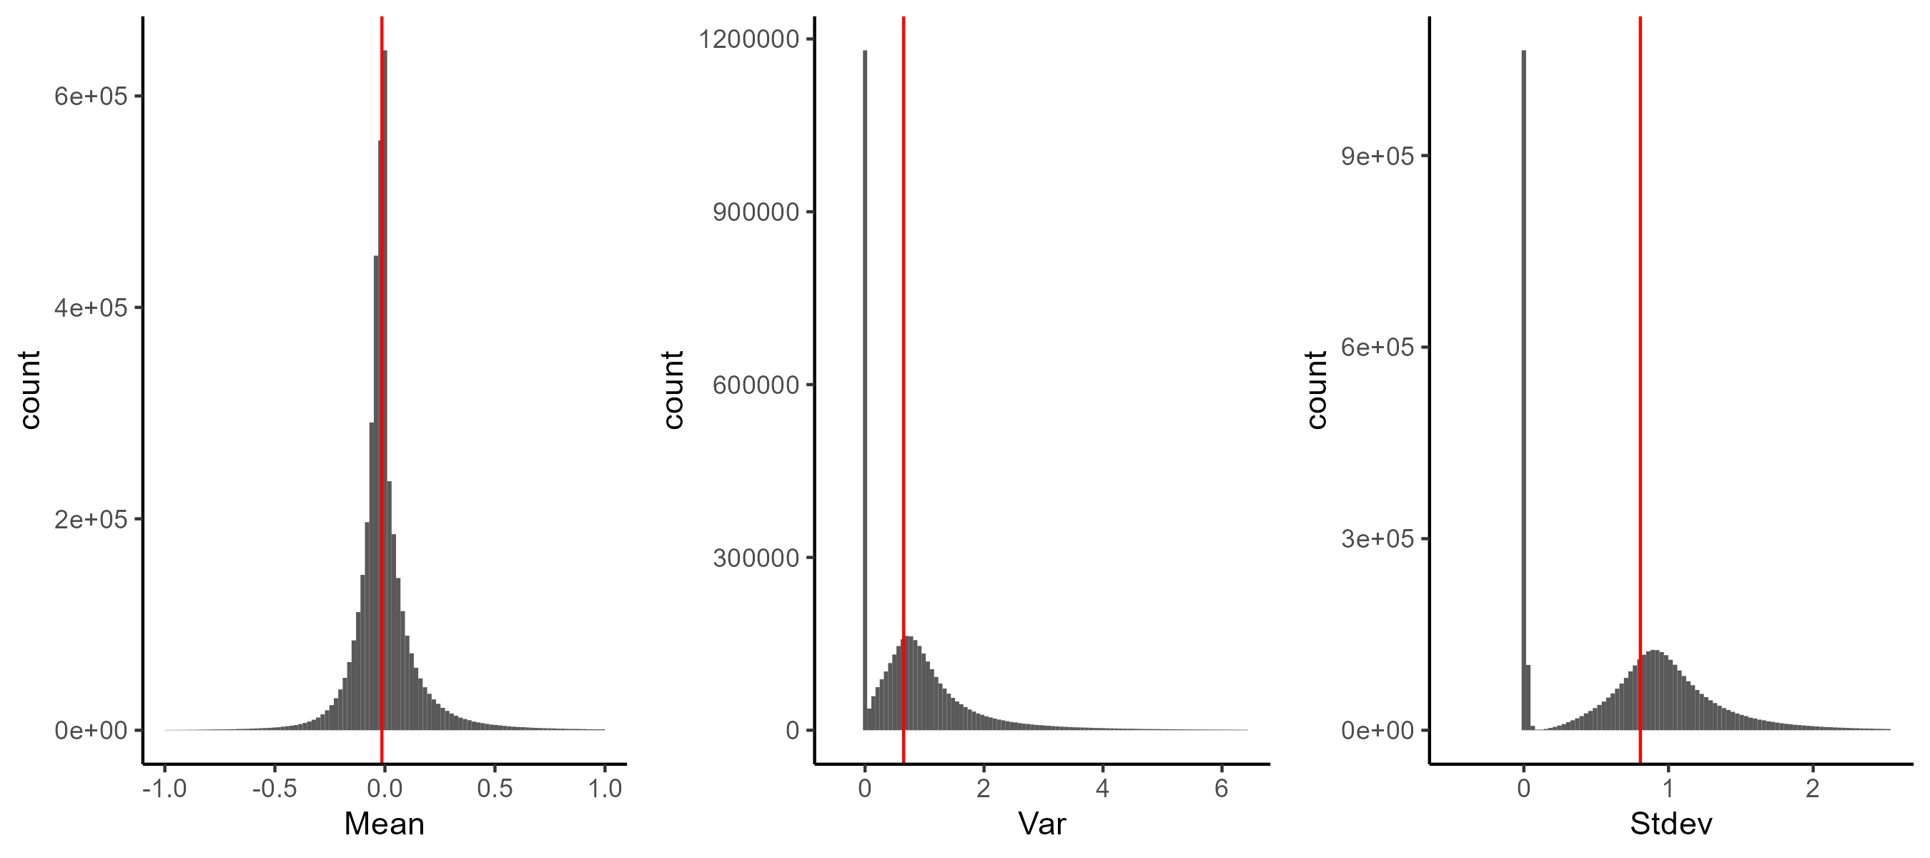
Keon Arbabi
07/29/22
18

Slide 19
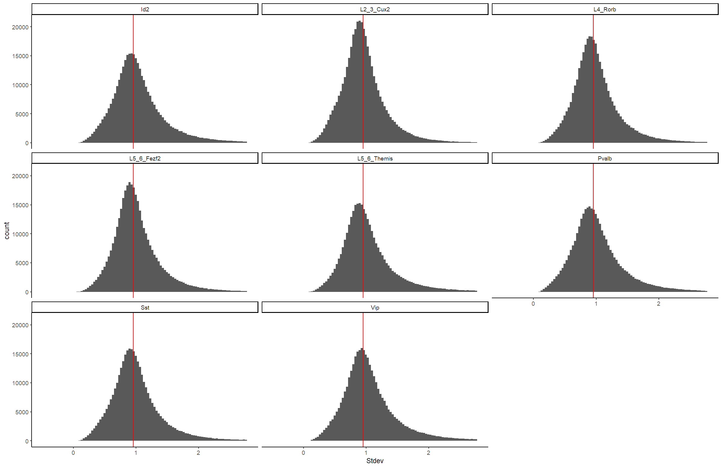
Keon Arbabi
07/29/22
19

Slide 20
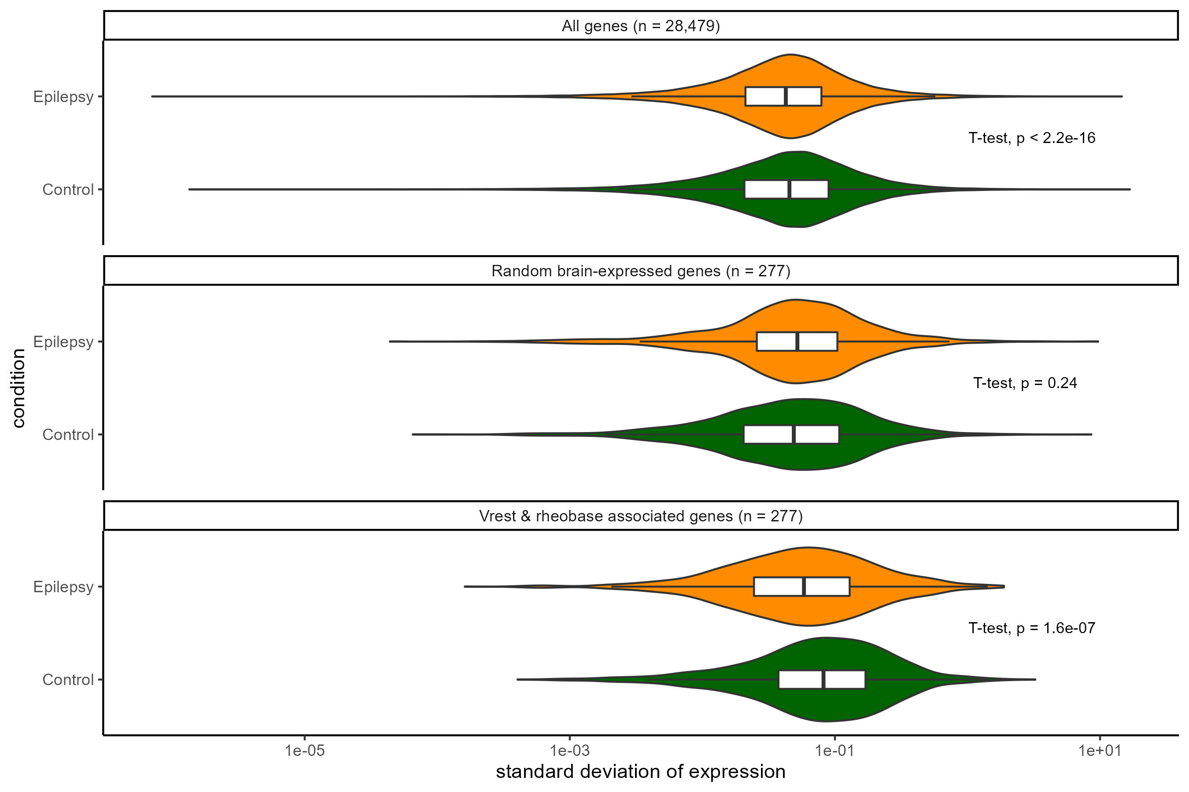
Keon Arbabi
07/29/22
20

